Slide 1

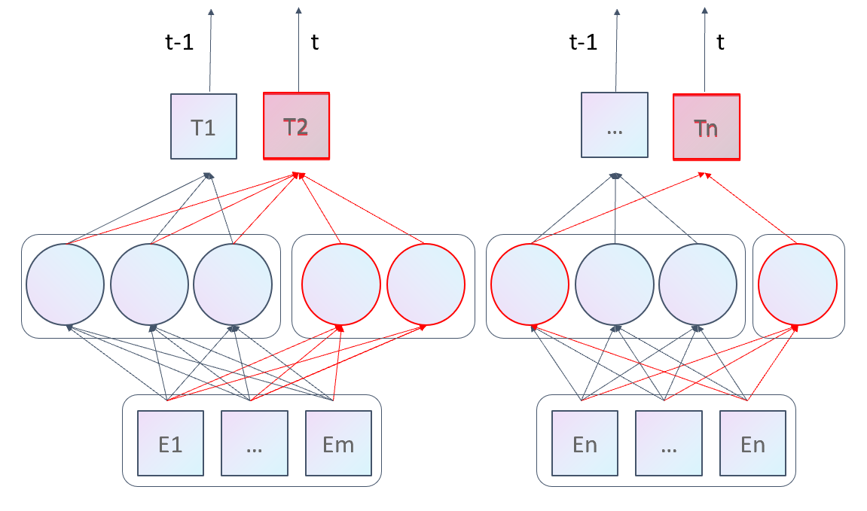
Incorrect!
Almost correct!
1 month
5.3 days
Halogens and a dicarbonyl group increase reactivity. In the absence of strong electron donors or acceptors, a high energy radical mechanism is probable.
Half Life of DTXSID70790800: FC(F)(F)C(Br)(C(Br) =O)C(F)(F)F
Half Life of DTXSID70790800: FC(F)(F)C(Br)(C(Br) =O)C(F)(F)F

Slide 2
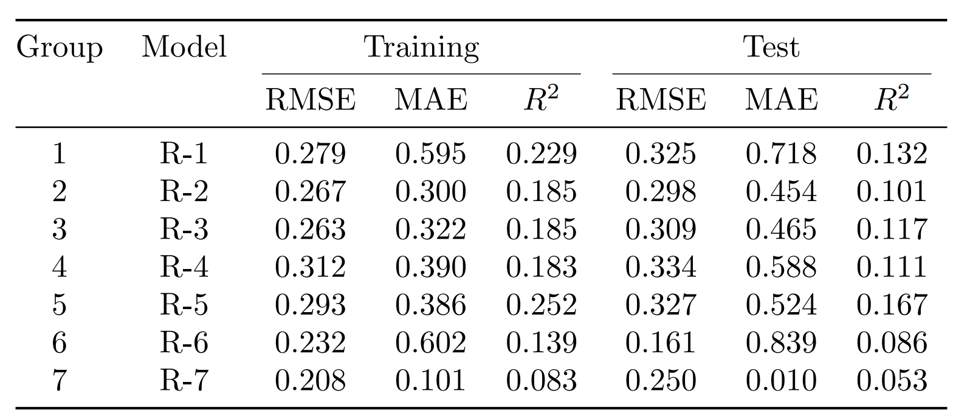

Slide 3
t-1
t
t-1
t
T1
T2
…
Tn
E1
…
Em
En
…
En
Notes:
Note:
1 hidden layer neural network
Author: Elvis Saravia (ellfae@gmail.com)

